Slide 1


HEP NTUA Top Angular Report 4/12/2020
George Bakas

Slide 2
Summary
Ttbar analysis:
Working on systematics
Consistency checks with Giannis
Next step is how to combine the 3 years
Angular Distributions, Z’ analysis:
New Signal Region:
SR_{C} = SR + mJJ > 1.5TeV
Using the new XSEC → Expected yield > 0!
2017: M: 3TeV and 3.5 TeV → 0 expected yield while M: 4TeV has ~ 15 events..
Stack histograms: (m_{Z’} 2, 2.5TeV and widths 1%, 10%)
Data vs MC (qcd scaled with k-factor to data)
TTbar scaled with signal strength
This plot can serve also as prefit distribution
Asymptotic Limits (Brazilian plots) for 2016, 2018

Slide 3
Angular Distributions (Prefit) 2016
M_{z’} =2000, w = 1%
M_{z’} =2500, w = 1%
M_{z’} =2000, w = 10%
M_{z’} =2500, w = 10%

Slide 4
Angular Distributions (Prefit) 2018
M_{z’} =2000, w = 1%
M_{z’} =2500, w = 1%
M_{z’} =2000, w = 10%
M_{z’} =2500, w = 10%

Slide 5
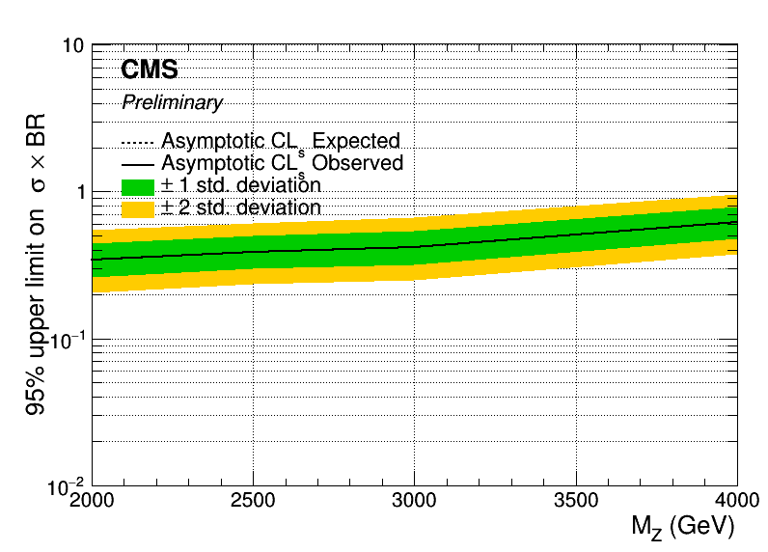
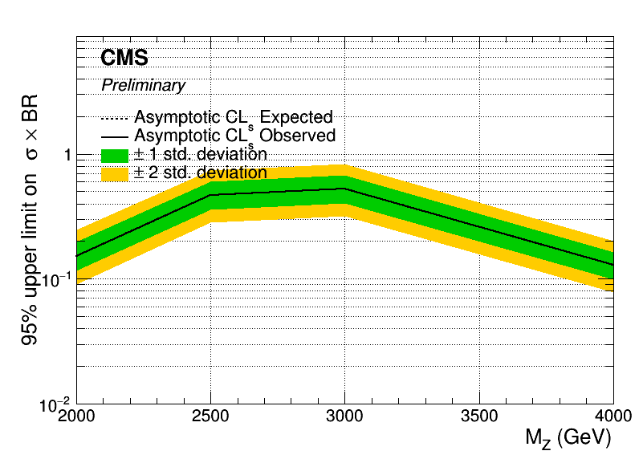
Assymptotic Limits 2016
Width = 1%
Width = 10%

Slide 6
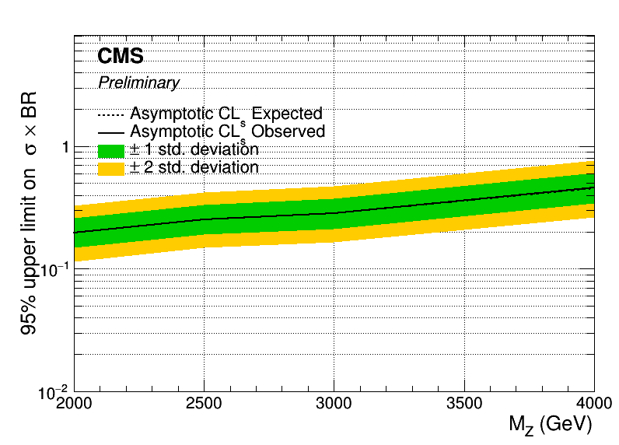
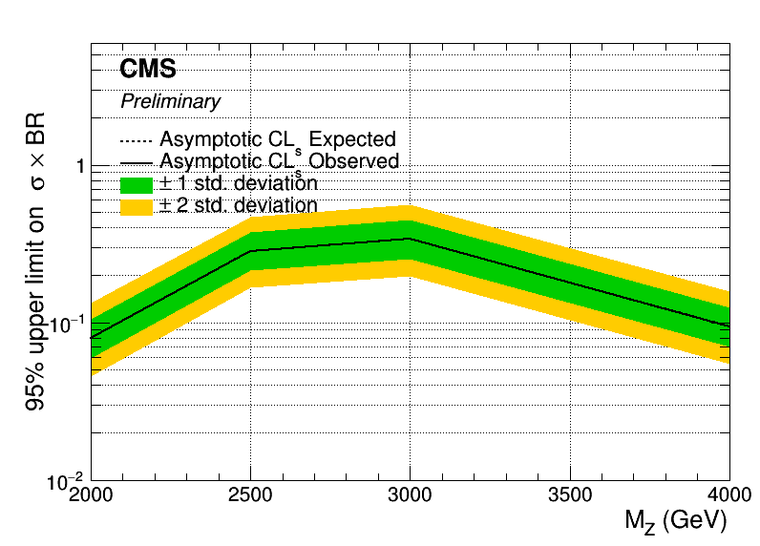
Assymptotic Limits 2018
Width = 1%
Width = 10%

Slide 7
BACKUP

Slide 8
Signal Selection
Control Region Selection
Variables | Selected Cut
pT (both leading jets) | > 400 GeV
Njets | > 1
N leptons | = 0
|eta| (both leading jets) | < 2.4
mJJ | > 1000 GeV
jetMassSoftDrop (only for fit) | (50,300) GeV
Top Tagger | > 0.2, 0, 0.1
B tagging (2 btagged jets) | > Medium WP
Signal Trigger
Variables | Selected Cut
pT (both leading jets) | > 400 GeV
Njets | > 1
N leptons | = 0
|eta| (both leading jets) | < 2.4
mJJ | > 1000 GeV
jetMassSoftDrop (only for fit) | (50,300) GeV
Top Tagger | > 0.2, 0, 0.1
B tagging (0 btagged jets) | < Medium WP
Control Trigger

Slide 9
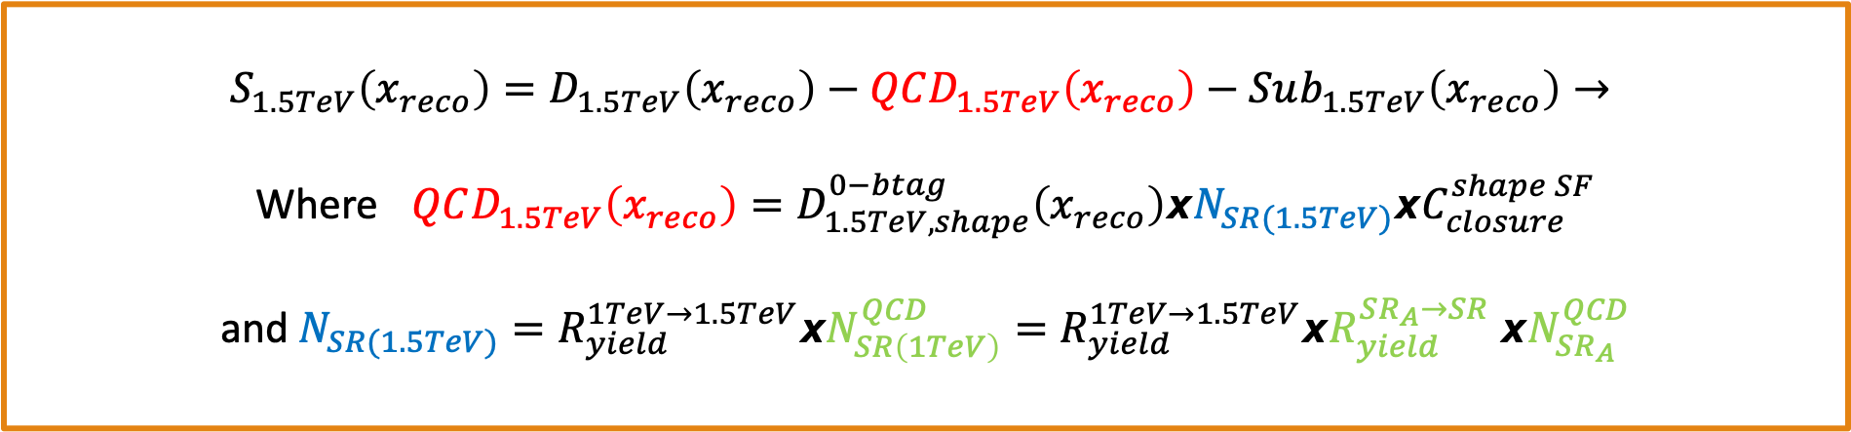
Signal Extraction
$$S_{1.5TeV}\left(x_{reco}\right)=D_{1.5TeV}\left(x_{reco}\right)−QCD_{1.5TeV}\left(x_{reco}\right)−Sub_{1.5TeV}\left(x_{reco}\right)→$$
Where $QCD_{1.5TeV}\left(x_{reco}\right)=D_{1.5TeV, shape}^{0−btag}\left(x_{reco}\right)xN_{SR(1.5TeV)}{xC}_{closure}^{shape SF}$
and $N_{SR(1.5TeV)}=R_{yield}^{1TeV→1.5TeV}xN_{SR\left(1TeV\right)}^{QCD}=R_{yield}^{1TeV→1.5TeV}xR_{yield}^{SR_{A}→SR} {xN}_{SR_{A}}^{QCD}$
The variable of interest here: x_{reco} → χ
1.5 TeV refers to the mJJ cut
We deploy a fit in the Signal Region (2btag) to extract the $N_{QCD}^{fit}$ in SRA (mJJ > 1TeV)
$$D{\left(m^{t}\right)}^{(i)}=N_{tt}^{(i)}T^{(i)}\left(m^{t},k_{MassScale}, k_{MassResolution}\right)+N_{bkg}^{(i)}B\left(m^{t} \right)\left(1+k_{1}x\right)+N_{sub}^{(i)}O^{(i)}\left(m^{t}\right)$$

Slide 10
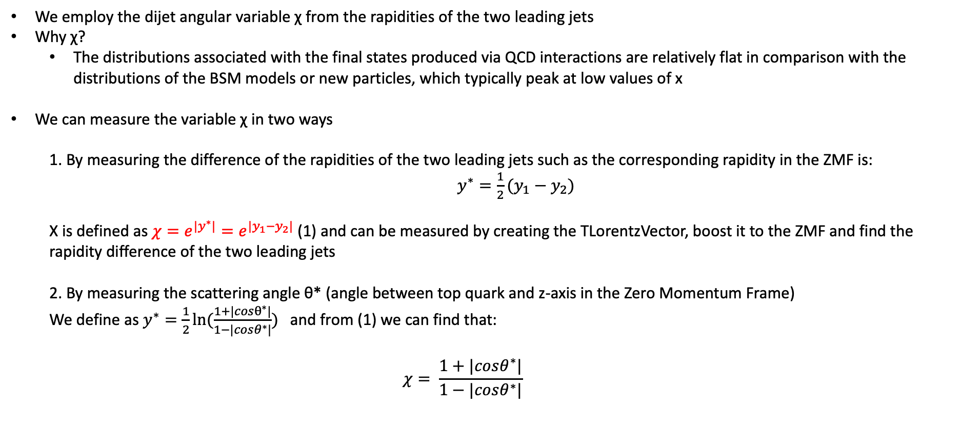
Top Angular Distributions
We employ the dijet angular variable χ from the rapidities of the two leading jets
Why χ?
The distributions associated with the final states produced via QCD interactions are relatively flat in comparison with the distributions of the BSM models or new particles, which typically peak at low values of x
We can measure the variable χ in two ways
1. By measuring the difference of the rapidities of the two leading jets such as the corresponding rapidity in the ZMF is: $y^{∗}=\frac{1}{2}(y_{1}−y_{2})$
Χ is defined as $χ=e^{{|y}^{∗}|}=e^{|y_{1}−y_{2}|}$ (1) and can be measured by creating the TLorentzVector, boost it to the ZMF and find the rapidity difference of the two leading jets
2. By measuring the scattering angle θ* (angle between top quark and z-axis in the Zero Momentum Frame)
We define as $y^{∗}=\frac{1}{2}ln⁡(\frac{1+|cosθ^{∗}|}{1−|cosθ^{∗}|})$ and from (1) we can find that:
$$χ= \frac{1+|cosθ^{∗}|}{1−|cosθ^{∗}|}$$

Slide 11
Angular Distributions (Prefit) 2017
M_{z’} =2000, w = 1%
M_{z’} =2500, w = 1%
M_{z’} =2000, w = 10%
M_{z’} =2500, w = 10%

